Slide 1


Real and Reactive Power Sharing Shipboard Power System Fundamentals Revision of 3 February 2026
Dr. Norbert Doerry
http://doerry.org/norbert/MarineElectricalPowerSystems/index.htm
© 2026 by Norbert Doerry This work is licensed via: CC BY 4.0 (https://creativecommons.org/)

Slide 2
Essential Questions
How are real and reactive power shared among generators? | Understand
How are real and reactive power shared among power electronic sources? | Understand
How are real and reactive power shared among combined generator and power electronic source systems? | Understand
How is the operating point calculated for multiple sources operating using droop? | Apply

Slide 3
Conditions when two ac power sources operate in parallel
Voltage magnitudes are equal …
If voltage drops in the interconnecting cable are negligible.
(Also true for two dc power sources)
Voltage frequencies are equal.
Voltage phase angles are equal …
If voltage drops in the interconnecting cable are negligible.
No automatic sharing of real and reactive power.
Must be implemented via a control mechanism.
(also true of two dc power sources for sharing real power)

Slide 4
Power control modes for individual sources
Swing source characteristic
Regulates voltage / frequency by providing whatever power (reactive or real) necessary to achieve set points.
Operator or control system input
Constant power sources.
Sources that provide power independent of load.
Droop characteristic
Voltage / frequency decreases as reactive / real power increases.
Cross-current compensation signals
Analog signals among paralleled sources that modify the voltage / speed reference of controllers.
Exchange of control signals among paralleled sources
Typically, digital signals that enable sharing.

Slide 5
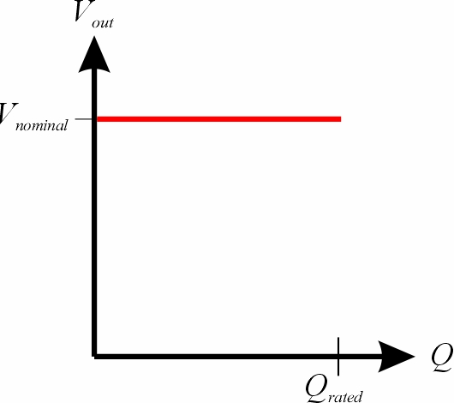
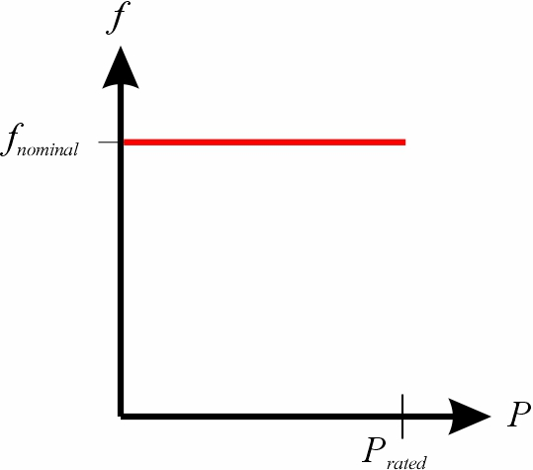
Swing Source
Acts as a grid forming source (establishes voltage and frequency)
A set of paralleled sources should at most have one swing source
The shore power connection typically acts as a swing source

Slide 6
Operator or control system input
Constant power source
Operator or control system specifies the amount of real or reactive power to provide.
May be employed by power system to minimize overall fuel consumption.
Grid following converters
Controlled current sources.
Cannot regulate a voltage magnitude or frequency
Amount of power provided is determined by the operator, power management system, or by the converter itself.
Examples …
Waste heat recovery systems
Photovoltaic systems
Regenerative braking converters (in lieu of dynamic braking resistors)
Requires at least one paralleled grid-forming source to establish voltage magnitude and frequency.

Slide 7
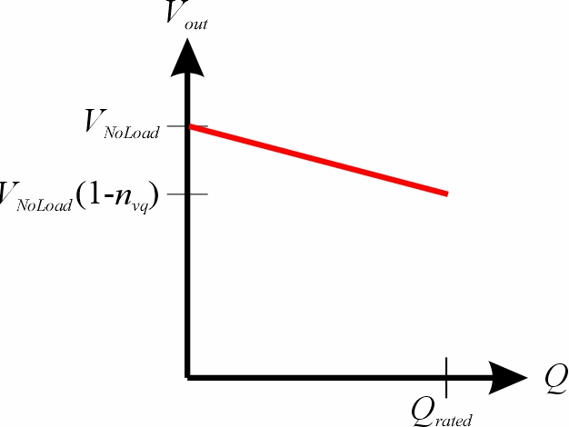
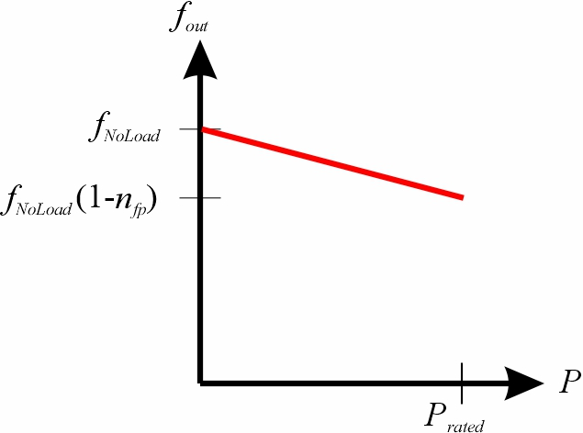
Droop characteristic
Acts as a grid forming source
AC systems
The reactive power provided is a linear function of voltage.
The real power provided is a linear function of frequency.
DC systems
The real power provided is a linear function of voltage.
Multiple paralleled droop sources
The voltage (frequency) is determined by the combined droop characteristic of all paralleled sources.
Paralleled with a swing source
The real (reactive) power provided depends on the voltage or frequency set point established by the swing source.

Slide 8
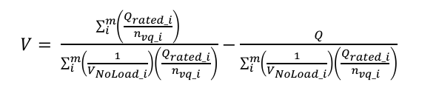
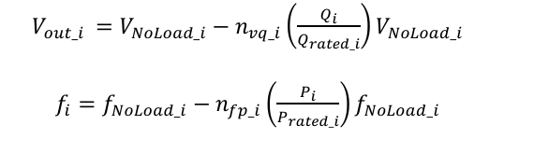
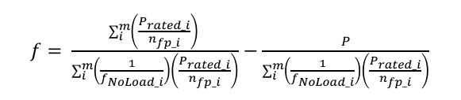
Combined Droop Characteristic (ac)
Droop equations for m paralleled droop sources
Droop equations for a single droop source
The voltage and frequency equations for a paralleled set of droop sources also have droop characteristics.
Power electronic inverters may implement droop through a virtual synchronous generator (VSG) by emulating a physical synchronous generator in controls.

Slide 9
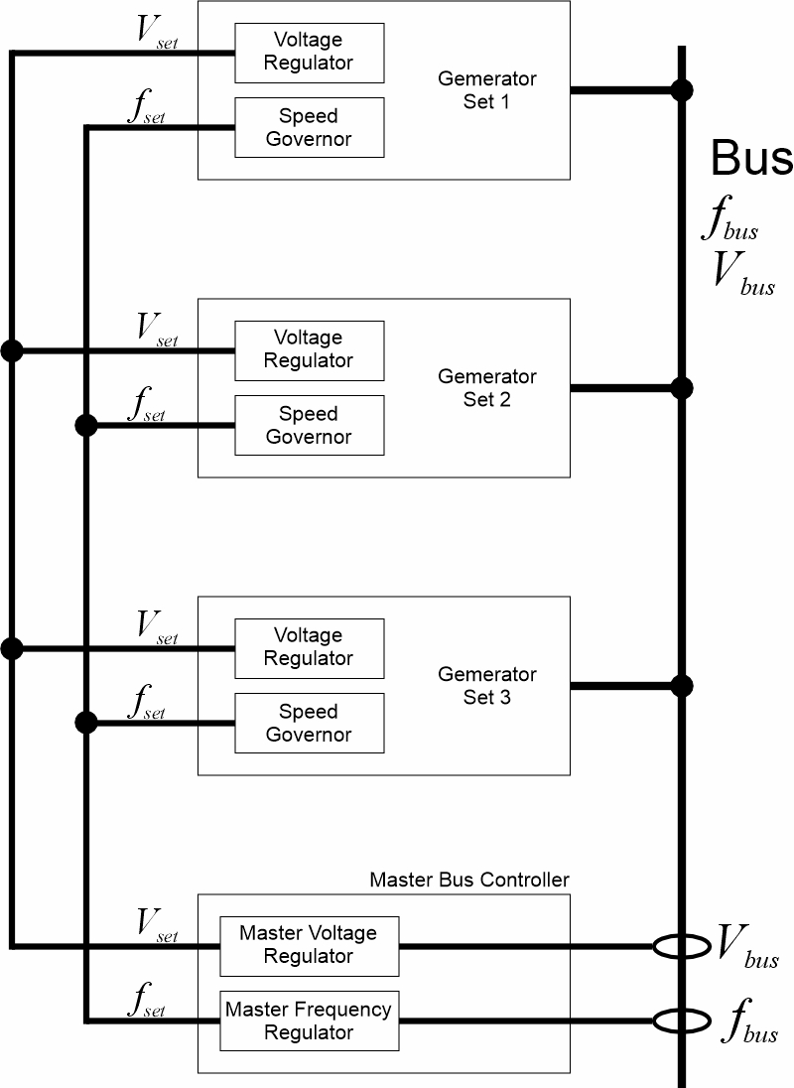
Master voltage (frequency) control for paralleled droop sources
A linear droop controller is specified by a no load value and the slope of the droop characteristic.
A master controller can adjust the no load value of all the paralleled droop sources so that the resulting bus voltage (frequency) is at its nominal value.

Slide 10
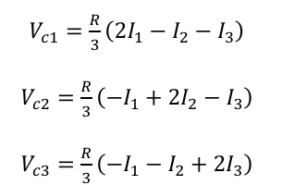
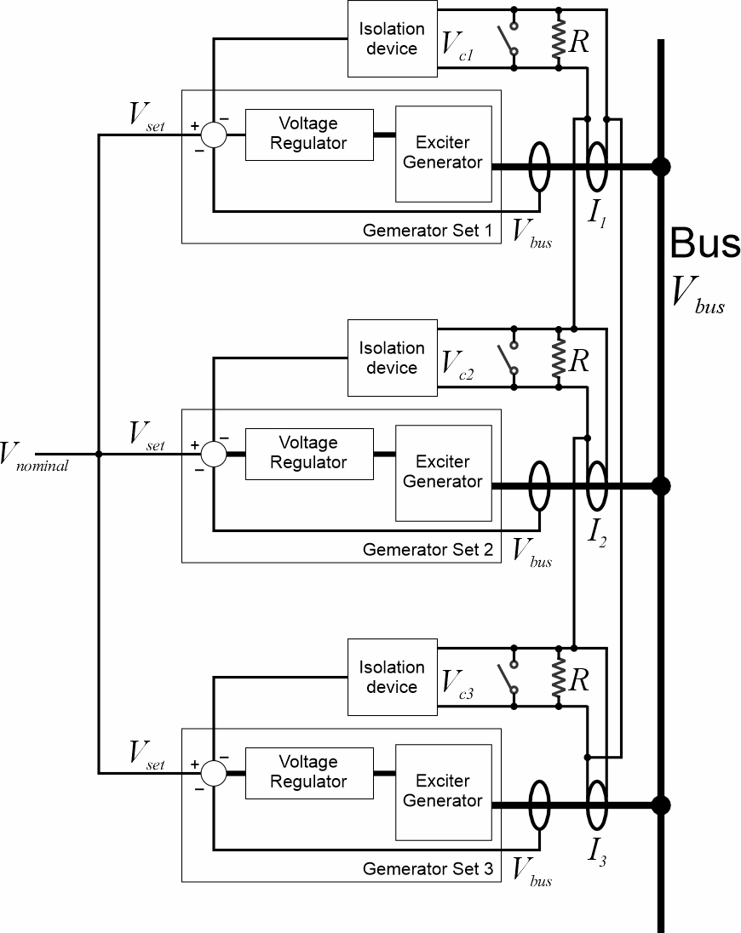
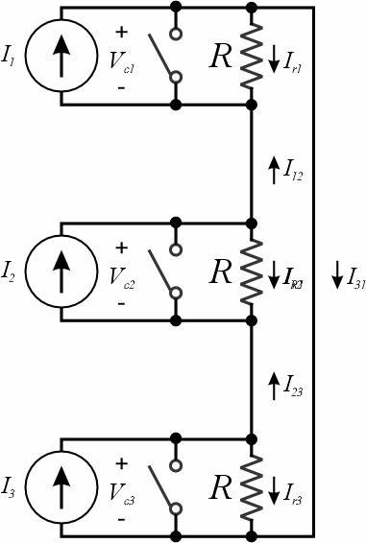
Cross Current Compensation
Acts as a grid forming source
Allows sharing reactive power while still regulating the voltage to its nominal value.
Each source has …
Current transformer
Burden Resistor
Switch (closed when source is not online)
Voltage across the burden resistor is used as feedback to regulator.
When all currents are equal, voltage is zero.

Slide 11
Exchange of control signals among paralleled sources
Digital controls enable exchange of data at high speeds.
Individual sources may be grid forming or grid following.
Standard protocols to enable digital control signal exchange among sources have not been established.
Proprietary protocols do exist, but currently cannot guarantee interoperability among sources from different manufacturers.
Lack of standard protocols complicates modeling and simulation.
Control signals may use a separate subnetwork.
Controller Area Network (CAN).
Power line communication (PLC).

Slide 12
Typical implementations
Generator sets only
Voltage regulation using droop or cross-current compensation.
Frequency regulation using droop with possible master frequency regulator.
Power electronic sources
May use droop or exchange control information.
AC sources may use the VSG concept to implement droop.
Combined generator sets and power electronic sources
May use droop or exchange control information.
AC power electron ic sources may use the VSG concept to implement droop.

